Slide 1
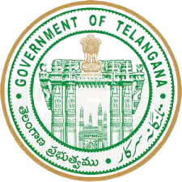

Telangana tourism insights domestic and foreign visitors
Created by
Hari chandu

Slide 2
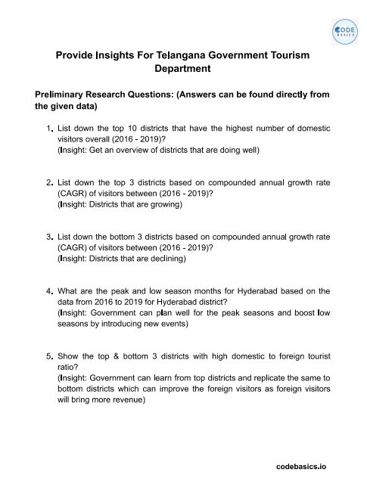
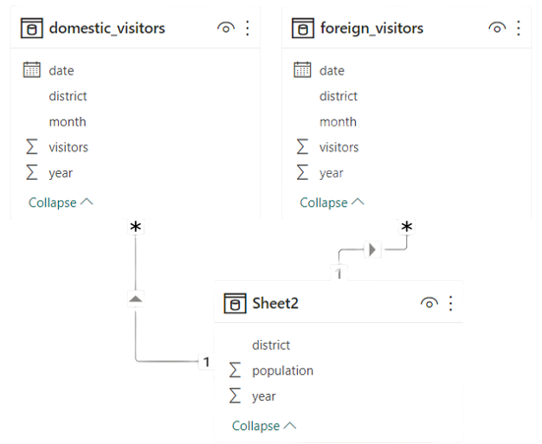
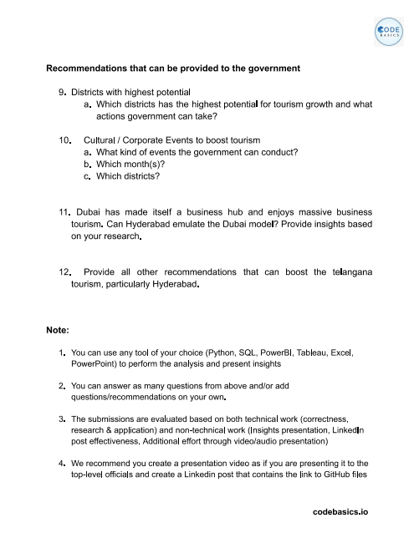
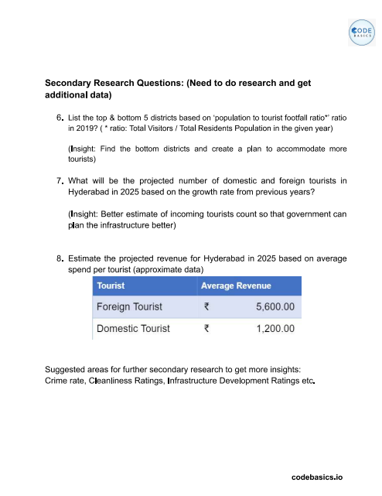



Data, Requests, and tools

Slide 3
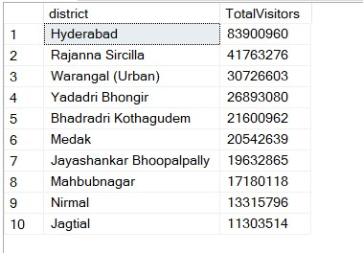
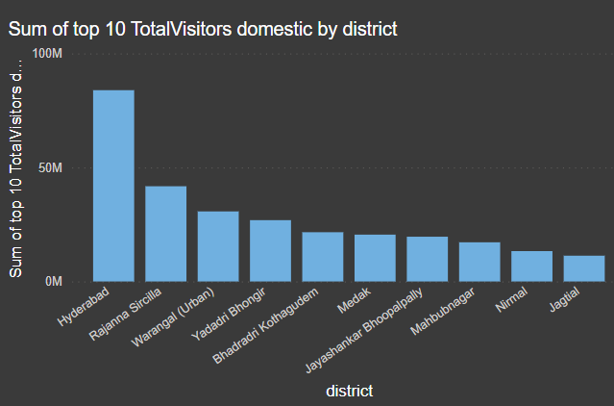
1)List down the top 10 districts that have the highest number of domestic visitors overall(2016 – 2019)
Top 10 districts with high domestic visitors overall

Slide 4
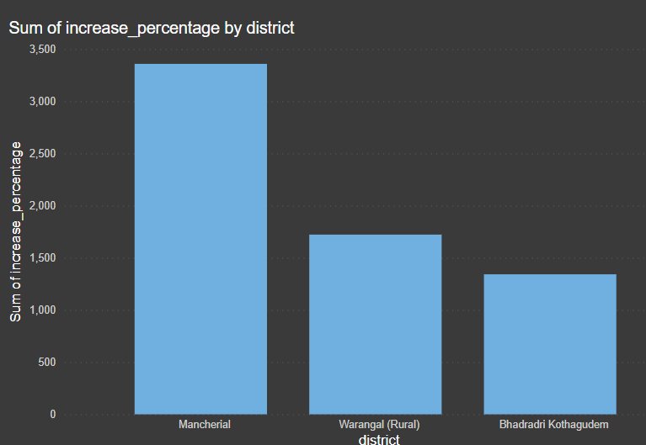
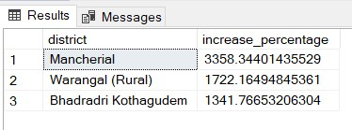
2) List down the top 3 districts based on compounded annual growth Rate of visitors between (2016 -2019)

Slide 5
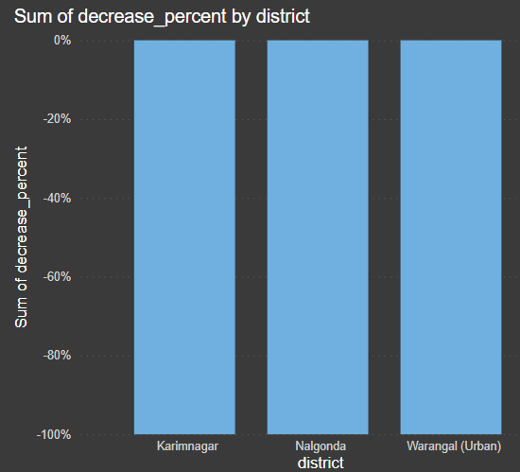
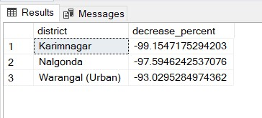
3) List down the bottom 3 districts based on compounded annual growth Rate of visitors between
(2016 -2019)
Insights:
Karimnagar and Nalgonda has a alarming rate
of decrease of visitors in 2016-2019

Slide 6
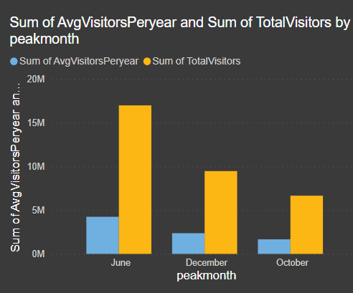
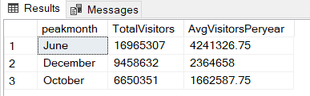
4) What are the high season months for Hyderabad district based on the data from
2016 to 2019

Slide 7
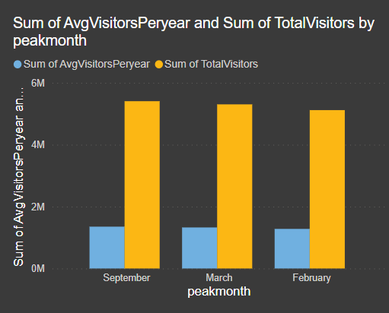
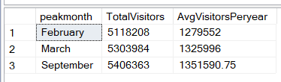
4) What are the low season months for Hyderabad district based on the data from 2016 to 2019
Insights :
Weather and exams time is main reason for the
low visitors for the domestic visitors

Slide 8
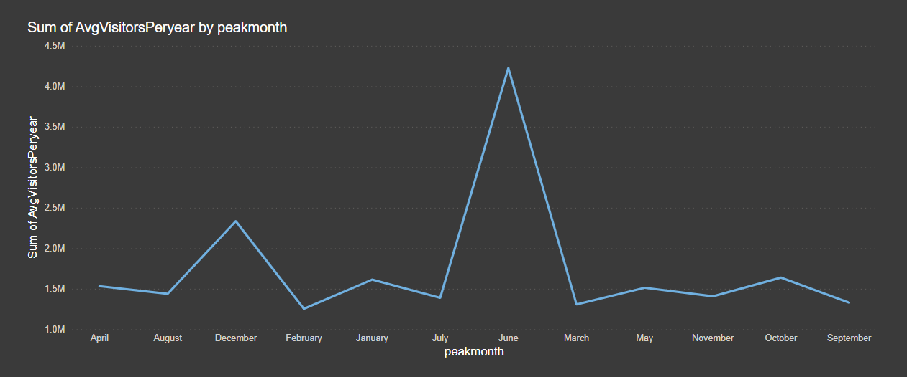
Domestic visitors
4.2M
2.3 M
1.6 M
Insights:
peak months of domestic and foreign are different.
For domestic visitors the peak months are June ,December ,October.

Slide 9
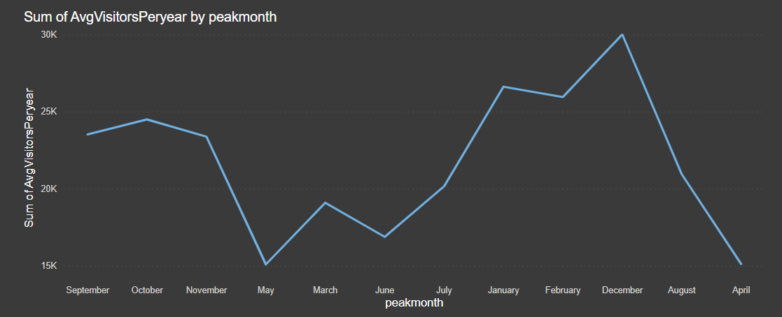
Foreign visitors
Insights:
The peak months of foreign visitors are December , January , February.
The low months are April , June , May.

Slide 10
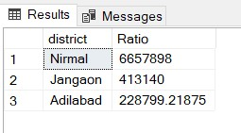
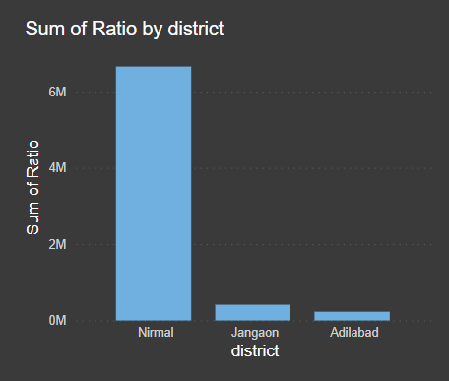
5) Show the top and bottom 3 districts with high domestic and foreign tourist ratio
Insights:
This districts has a high of tourists from domestic than
Foreign visitors
Suggestions :
Promotional efforts to bring foreign visitors

Slide 11
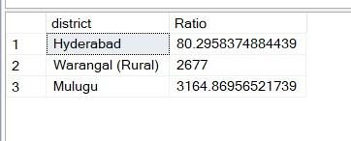
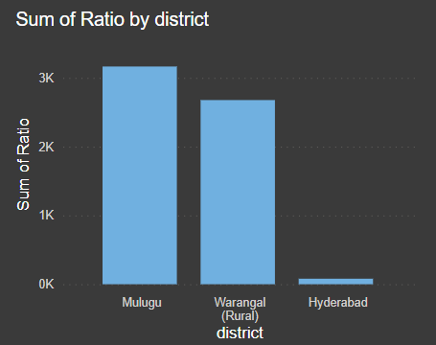
5) Show the top and bottom 3 districts with high domestic and foreign tourist ratio
Insights:
Hyderabad has highest number of Foreign visitors in telangana.

Slide 12
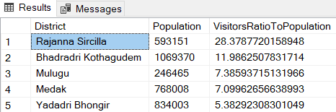
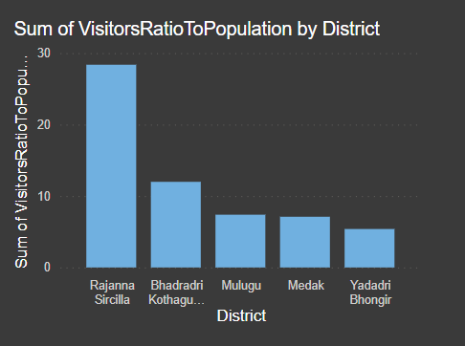
6) List top and bottom 5 districts based on population to tourist footfall ratio in 2019

Slide 13
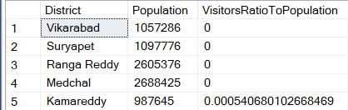
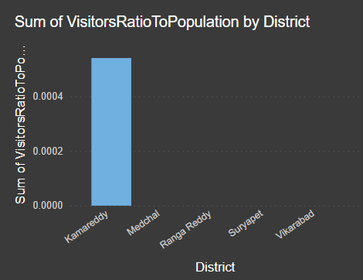
6) List top and bottom 5 districts based on population to tourist footfall ratio in 2019
This districts has no visitors

Slide 14
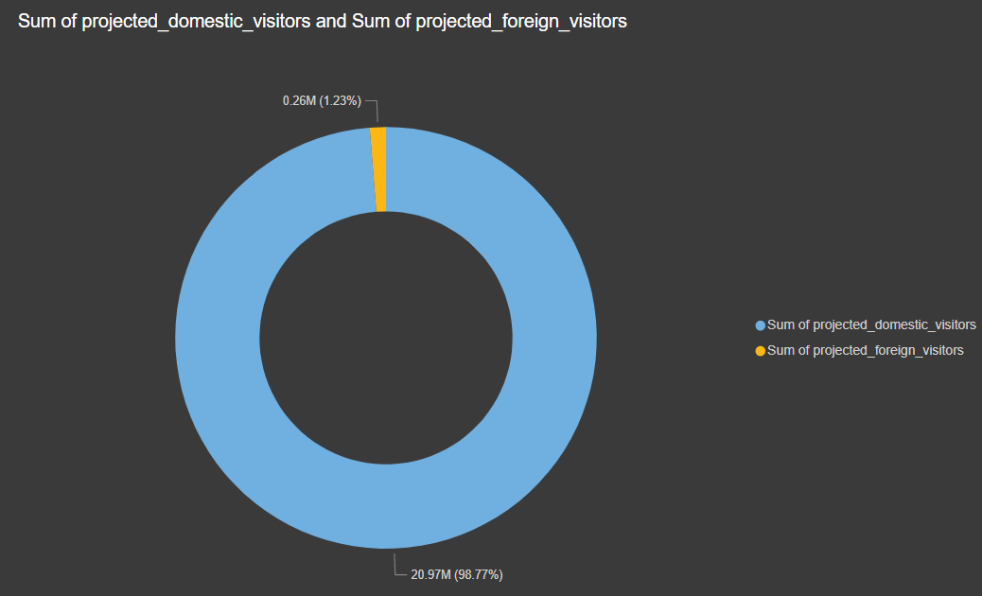

7) What will be the projected number of domestic and foreign tourist in Hyderabad in 2025
based on the growth rate from previous years
Insights:
there will be a 35% increase in visitors in
2025.

Slide 15
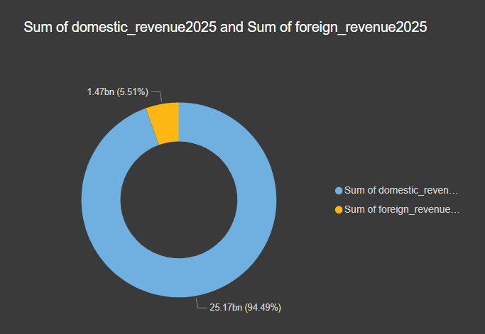

8) Estimate the projected revenue for Hyderabad in 2025 based on average spending per tourist
Insights:
There will be 30% increase in revenue

Slide 16
Recommendations
9) Districts with high potential
Which districts has the highest potential for tourism growth and what actions government can take
Warangal - historical monuments, temples, and natural attractions such as the Pakhal Lake
and Etunagaram Wildlife Sanctuary
The government can focus on promoting Warangal's rich cultural heritage through events, festivals, and tours.
Adilabad - rich biodiversity and natural attractions such as Kala Ashram, Kadam Dam, and Pochera Waterfalls
The government can focus on promoting ecotourism in Adilabad and developing facilities such as eco-lodges
and trekking trails.
Karimnagar - has several temples, forts, and natural attractions such as the Lower Manair Dam and Kondagattu Anjaneya
Swamy temple
The government can promote Karimnagar as a cultural and adventure tourism destination by organizing events such as treks,
temple tours

Slide 17
10) Cultural and corporate events to boost tourism
What kind of events the government can conduct
Which month(s)
Which districts
Karimnagar - traditional arts and crafts - January and February.
Adilabad district - adventure sports events -November to February.
Khammam - host music and dance events - March and April.

Slide 18
11) Dubai has made itself a business hub and enjoy massive business tourism can Hyderabad emulate the Dubai model ?
Diversifying tourism : High end tourism , cultural tourism , adventure tourism.
Marketing and promotions : Effective marketing and promotion can significantly boost tourism.
Hyderabad can create a business-friendly environment and streamlined processes to attract more
investments in tourism, following Dubai's example.
Hyderabad can attract more tourists by investing in its infrastructure and building world-class attractions,
similar to Dubai's approach

Slide 19
12) Provide all other recommendations that can boost telangana tourism, particularly Hyderabad
Developing tourist infrastructure.
Promoting the districts as tourist destinations.
Improving the quality of tourist services.
Encouraging community involvement.
Ensuring sustainability.
Dubai is heavily dependent on high end tourism so diversifying is important.
the impact of tourism development on the environment and the local community.

Slide 20
Thank you Code basics and Telangana government

